Slide 1


E-commerce Product Description Generator

Slide 2

CONTENTS
1. Introduction
2. Tools and Technologies
3. Project Workflow
4. Code Explanation
5. Challenges Faced
6. Conclusion
7. Visuals

Slide 3

01
Introduction

Slide 4
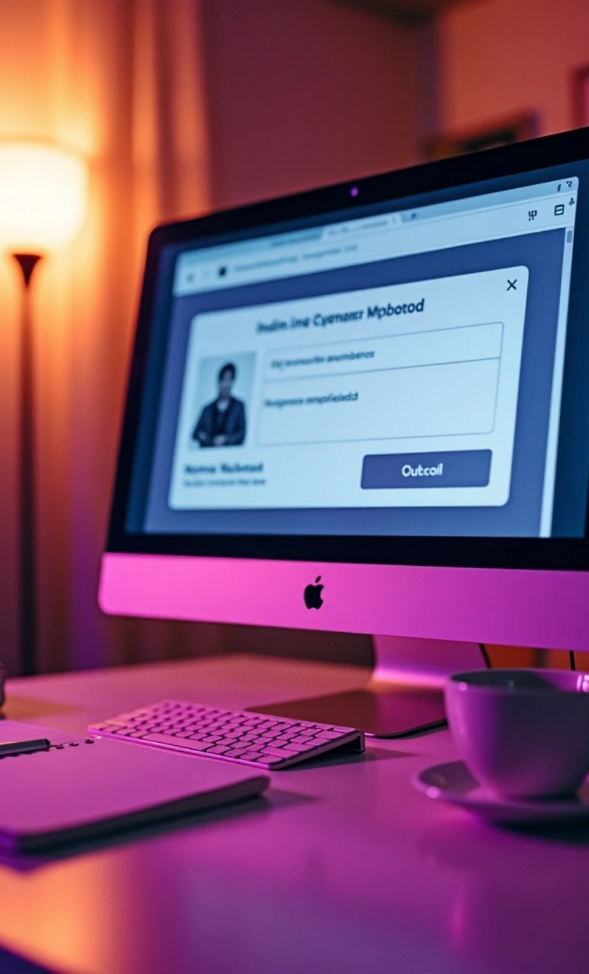
About the Project
The project is named "E-commerce Product Description Generator". It allows users to input a product link and a description, and it generates a structured product description using an AI-based API.

Slide 5



Objectives
The main objectives of this project are:
1
To simplify the process of generating product descriptions.
2
To use AI to provide detailed and informative outputs.

Slide 6

02
Tools and Technologies

Slide 7
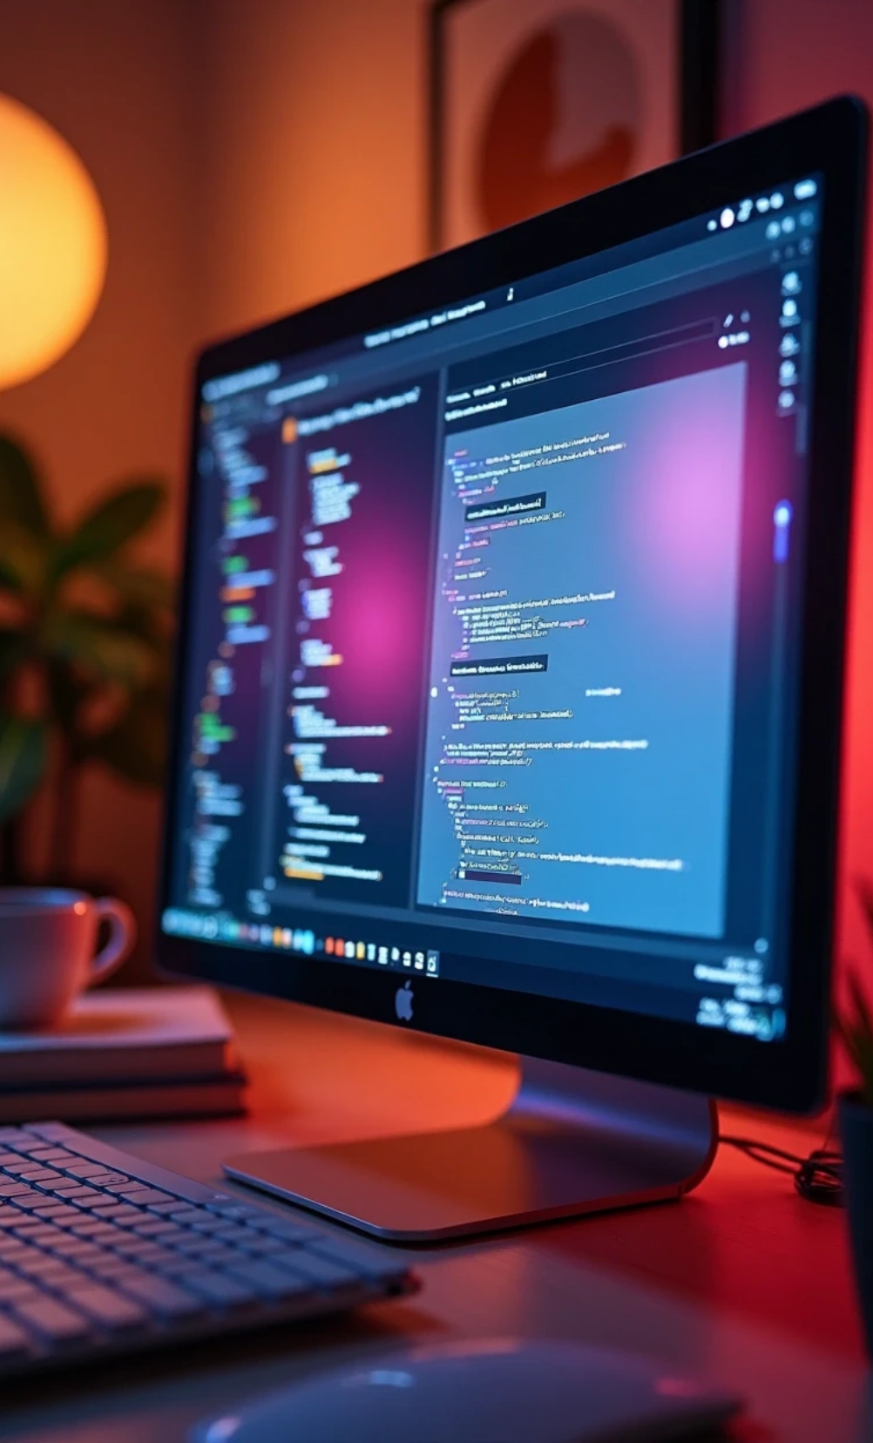
Frontend
The frontend is developed using Flask, which allows for rendering HTML templates and handling web forms.

Slide 8

Backend
The backend leverages the Groq API for AI-driven content generation. Environment variables are managed using the dotenv library.

Slide 9

Libraries Used
1
Flask
2
dotenv
3
Groq

Slide 10

03
Project Workflow

Slide 11

Description of Workflow
1
User inputs a product link and description.
2
The input is sent to the backend for processing.
3
The backend calls the Groq API to analyze the product.
4
The API returns a structured product description.
5
The result is displayed to the user.

Slide 12

04
Code Explanation

Slide 13

Code Overview
import os import re import json import dotenv from flask import Flask, render_template, request, redirect, url_for, session from groq import Groq /# Load environment variables dotenv.load_dotenv() groq_api = os.getenv("GROQ_API_KEY") /# Match the .env variable name client = Groq(api_key=groq_api) /# Initialize Flask app app = Flask(_name_) app.secret_key = 'your_secret_key_here' /# Replace with something secure

Slide 14
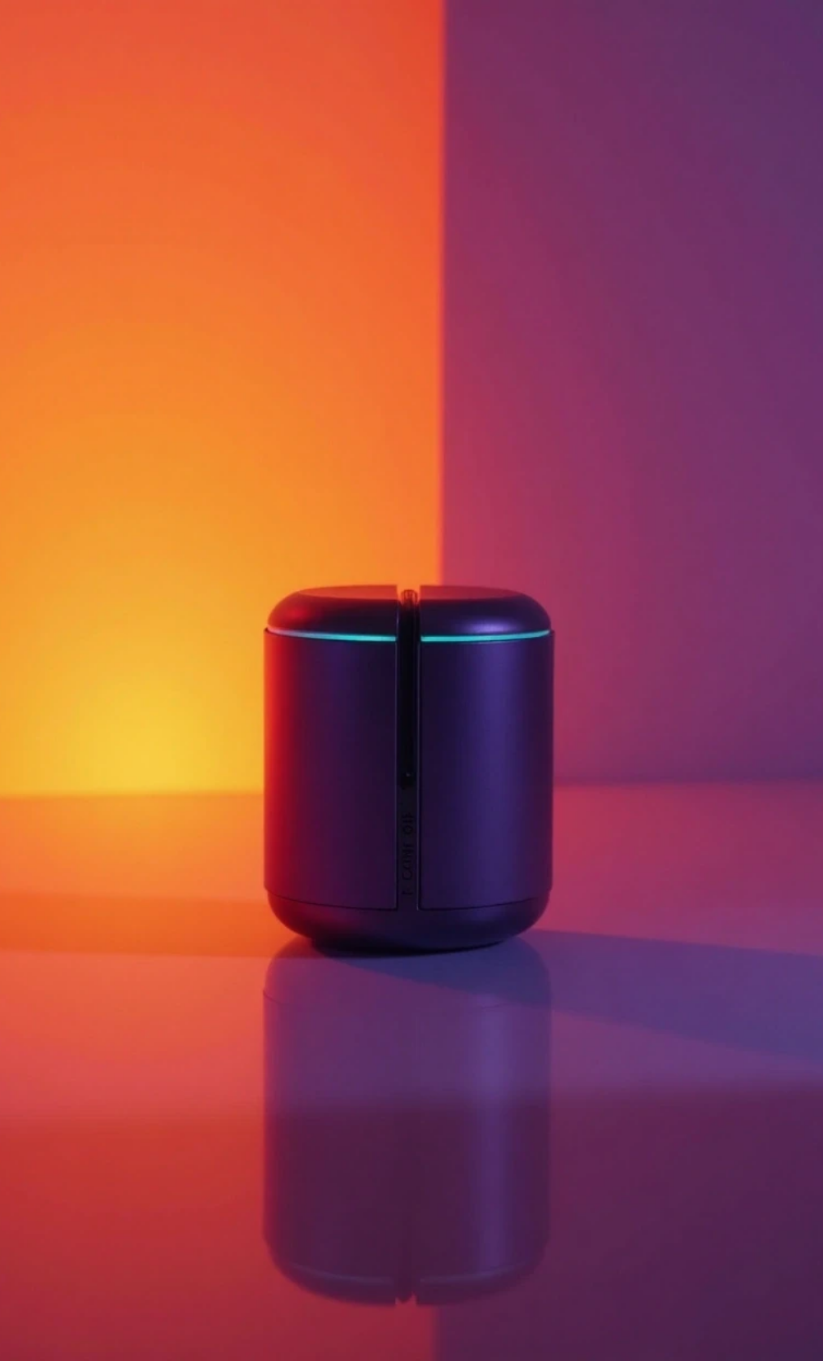
Function: analyze_product
This function processes the product link and description, generates a prompt for the AI, and handles the response.

Slide 15
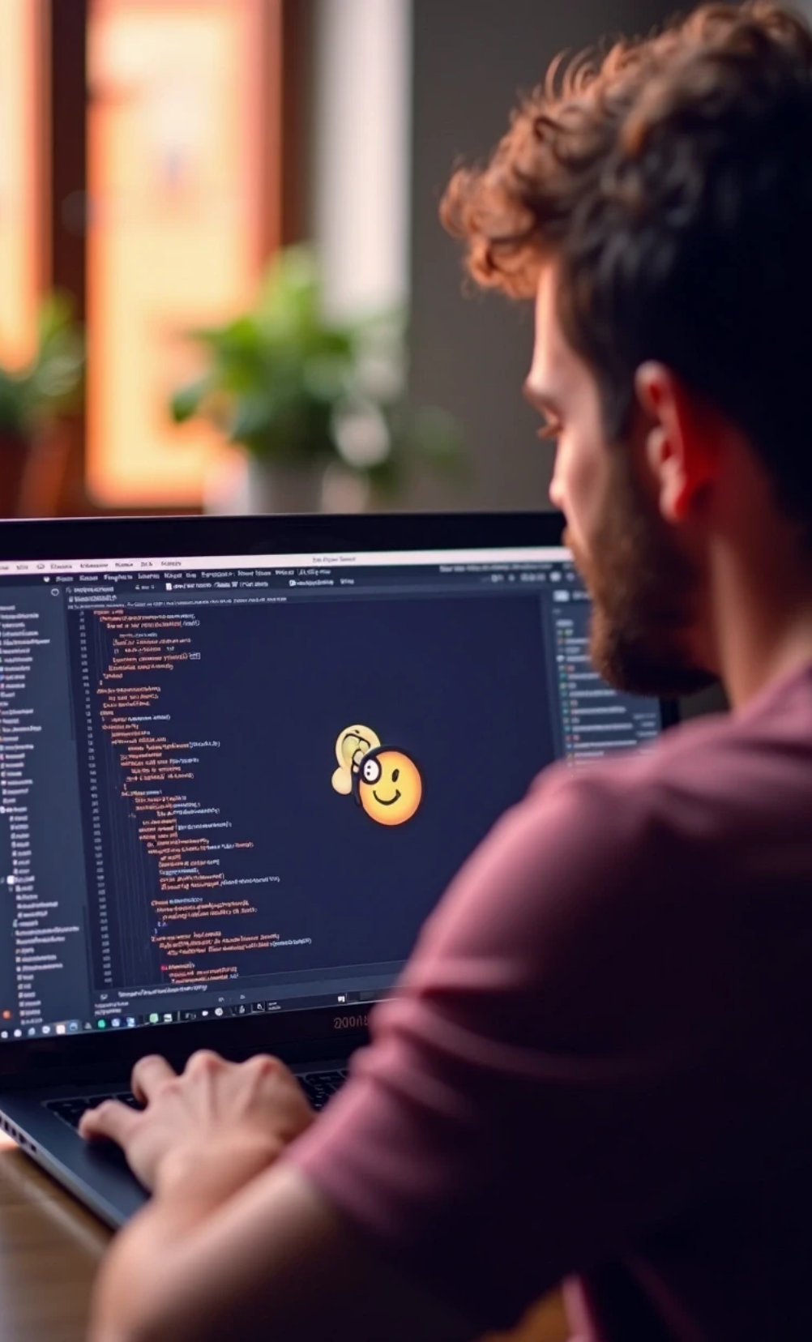
Flask Route: index
This route handles both GET and POST requests, processing user input and displaying results.

Slide 16

05
Challenges Faced

Slide 17



Challenges Faced
1
Technical Challenges
2
Design Challenges
• Integrating the Groq API with Flask.
• Creating an intuitive user interface that effectively communicates with users.
• Handling API response parsing and error management.

Slide 18
06
Conclusion

Slide 19
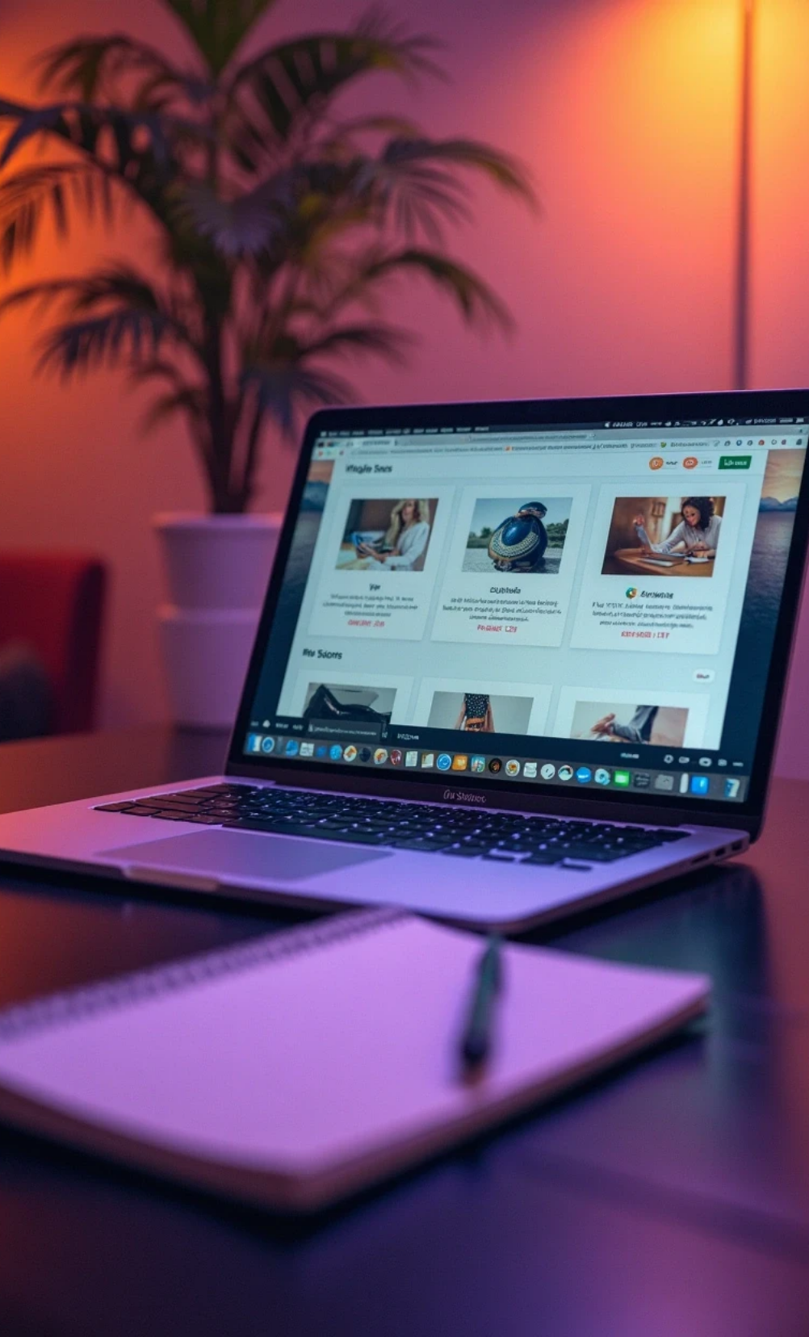
Conclusion
The "E-commerce Product Description Generator" project successfully demonstrates how AI can enhance product descriptions in e-commerce. The integration of Flask with the Groq API provides a seamless user experience.

Slide 20

Future Work
Future improvements could include:
Expanding the AI model to support more languages.
Enhancing the user interface with more visual elements.

Slide 21
07
Visuals

Slide 22

Thank You

